Slide 1




NEXT GEN EMPLOYABILITY PROGRAM
Creating a future-ready workforce
Team Members
College Name
Student Name :R.M.MABISHA
Student ID : au960221104069
Arunachala college of engineering for women

Slide 2

CAPSTONE PROJECT SHOWCASE
Project Title
Car Rentals Application with Django Fram
Abstract | Problem Statement | Project Overview | Proposed Solution | Technology Used | Modelling & Results | Conclusion

Slide 3
Abstract: In the era of digital transformation, the automotive industry has witnessed a significant shift towards online platforms for car rentals. To meet the evolving demands of modern consumers, an efficient and user-friendly car rentals application is essential. This presentation focuses on the development and implementation of such an application utilizing the Django framework. Django, a high-level Python web framework, offers a robust toolkit for building web applications quickly and securely. Leveraging Django's features such as authentication, ORM (Object-Relational Mapping), and templating engine, we have crafted a comprehensive solution for car rentals.
Source :

Slide 4
Problem Statement: Design and develop a Car Rentals Application using the Django Framework. The application should facilitate the rental of cars by customers with features such as browsing available cars, making reservations, and managing rental bookings. Requirements are used here are: 1. User Authentication: Implement user authentication and authorization for customers and administrators. 2. Car Management: Admins should be able to add, edit, and delete cars from the inventory. Cars should have attributes such as make, model, year, color, price, availability status, etc. Customers should be able to browse available cars and view their details. 3. Booking System: Customers should be able to select a car, specify rental duration, and make reservations. 4. User Interface: Design an intuitive and user-friendly interface for both customers and administrators. 5. Testing and Deployment: *Conduct thorough testing to ensure functionality and reliability. *Deploy the application on a reliable hosting platform with proper server configurations.
Source :

Slide 5
Project Overview: The Car Rentals Application built with the Django Framework aims to provide users with a seamless platform for renting vehicles. Through this application, users can easily search for available cars based on their preferences such as location, date, and vehicle type. They can also make reservations, manage bookings, and handle payments securely. The admin panel allows administrators to efficiently manage vehicle listings, user accounts, bookings, and monitor overall operations. With intuitive user interfaces and robust backend functionalities, the Car Rentals Application streamlines the process of renting cars, offering convenience and reliability to both customers and administrators alike.
Source :

Slide 6
Proposed Solution: Proposed solution for Car Rentals Application with Django Framework: A)Setup: We'll use Django, a framework for building web applications in Python. First, we set up our project and create different parts like the website itself and the database. B)Data Design: We plan what information we need to store, like details about cars, customers, and rentals. We organize this information into tables in our database. C)Admin Interface: We create a simple way to manage our data using Django's built-in admin interface. This allows us to add, edit, and delete cars, customers, and rentals easily.
.
Source :

Slide 7
D)User Interaction: We design the pages where users can view available cars, rent a car, and return it. These pages will be accessible through web addresses (URLs).
E)Forms and Validation: We create forms for users to input their information when renting a car. We make sure this information is correct and complete before accepting it.
F)User Authentication: We implement a way for users to sign up and log in to the website securely. This ensures that only authorized users can rent cars.
G)Frontend Design: We make the website look good by designing its layout and adding colors, fonts, and images. This includes making it easy for users to navigate and understand.
Source :

Slide 8
H)Testing: We check that everything works as expected by testing the website thoroughly. This ensures that users won't encounter any bugs or errors when using it.
I)Deployment: Once everything is ready, we deploy the website to a server so that people can access it online. This involves configuring the server and making sure the website is secure.
J)Maintenance: We keep an eye on the website to make sure it continues to run smoothly. This includes fixing any issues that arise and updating it with new features as needed.
Overall, our goal is to create a user-friendly website where people can easily rent cars and manage their rentals with no hassle.
Source :

Slide 9


Technology Used
Front-end
Back-end
Source :

Slide 10
Modelling & Results: Modeling: We start by thinking about what kinds of information we need to keep track of in our car rental application. We identify the main entities: cars, customers, and rentals. For each entity, we define the attributes or characteristics it should have. For example, a car might have attributes like make, model, year, and availability status. A customer might have attributes like name, email, and phone number. We also think about how these entities are related to each other. For instance, a rental is associated with a specific car and customer, and it has attributes like rental start date, end date, and total cost. Using Django's modeling system, we create classes to represent each entity and define the attributes and relationships between them. This is done using simple Python code. Results: With our models in place, we can start using our car rental application. We can add cars to our database by entering their details, such as make, model, and year. Customers can sign up and provide their information, like name, email, and phone number. When a customer wants to rent a car, they can search for available cars and select one. Once a rental is confirmed, the rental details are stored in the database, including the start date, end date, and total cost. Customers can view their rental history and current rentals. The application automatically updates the availability status of cars based on rentals. Admins can manage the database, add new cars, view customer information, and handle rental transactions. Overall, the application helps manage the process of renting cars efficiently, keeping track of inventory, customer information, and rental transactions.
Source :

Slide 11
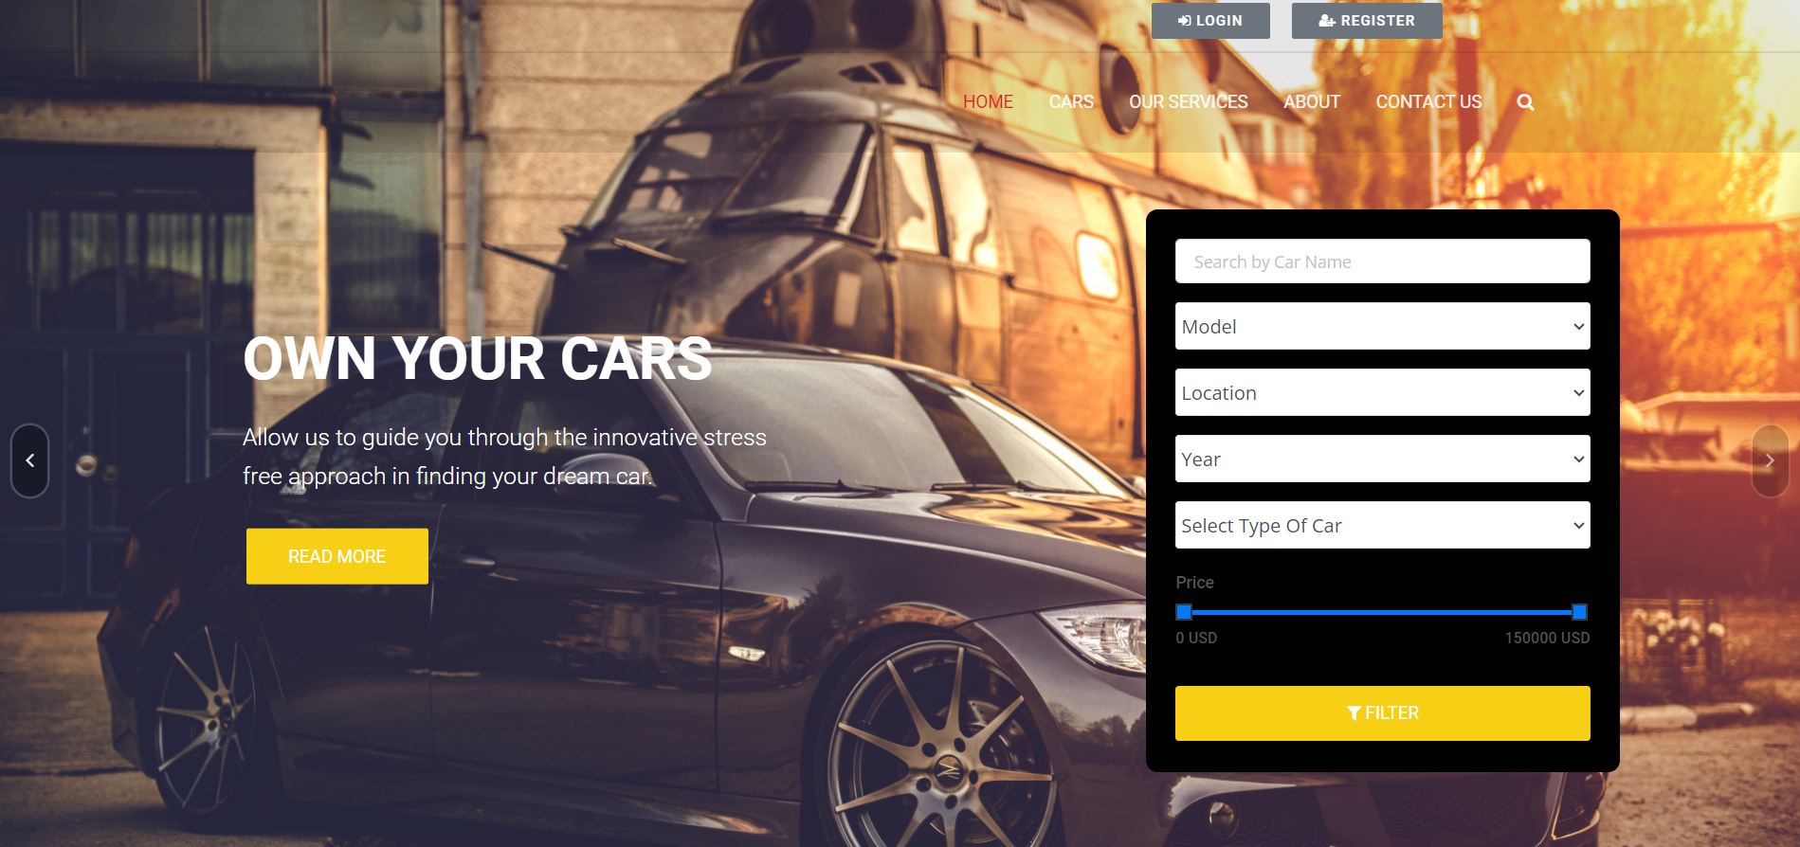
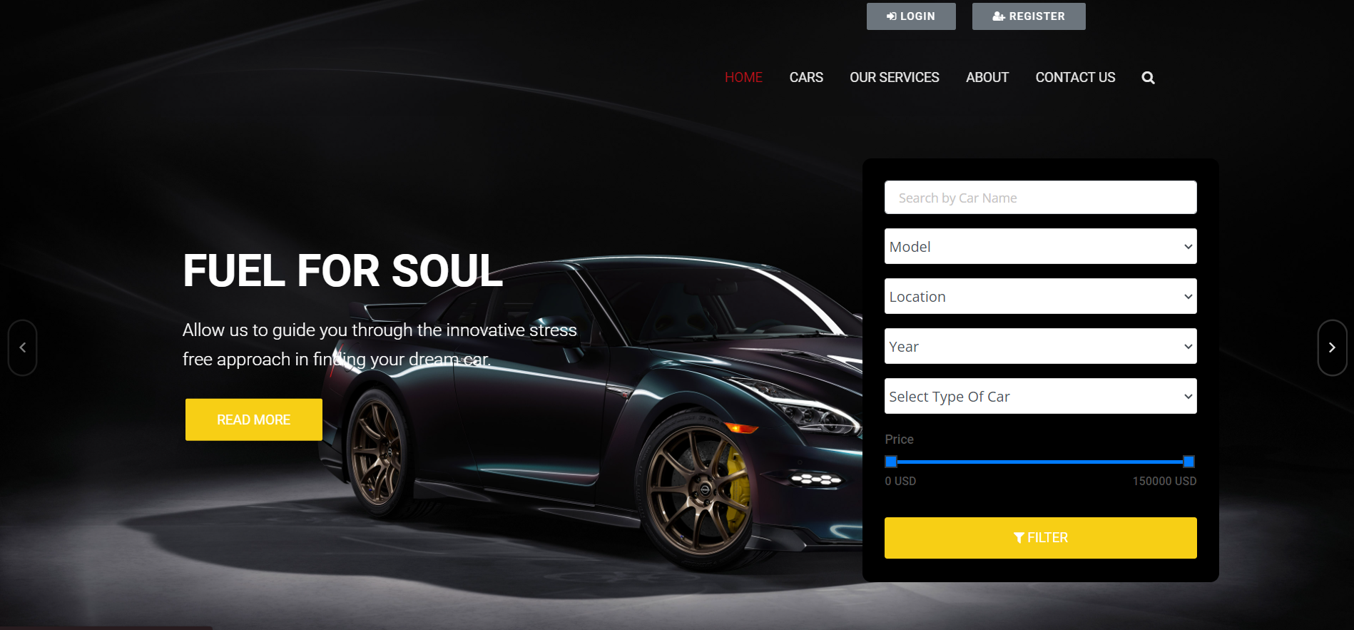
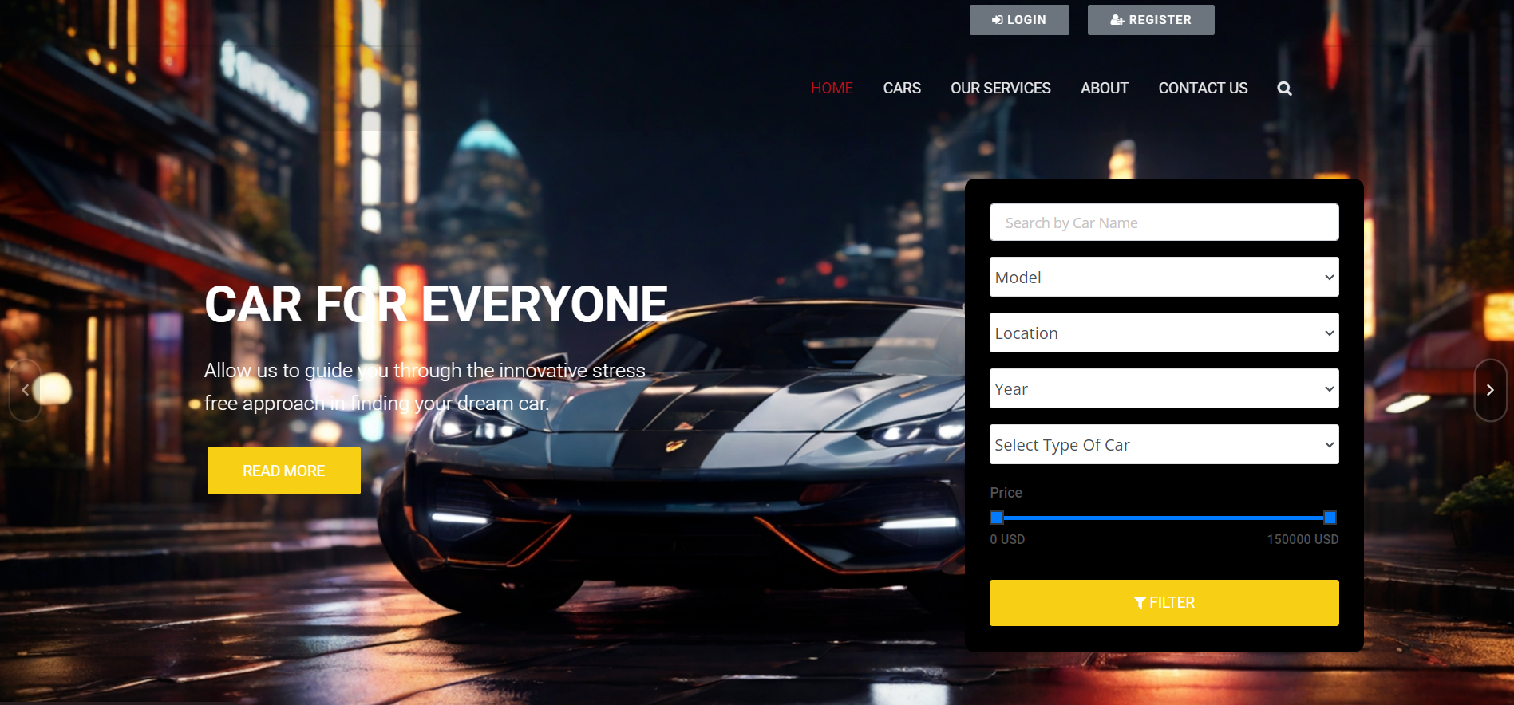
Homepage

Slide 12
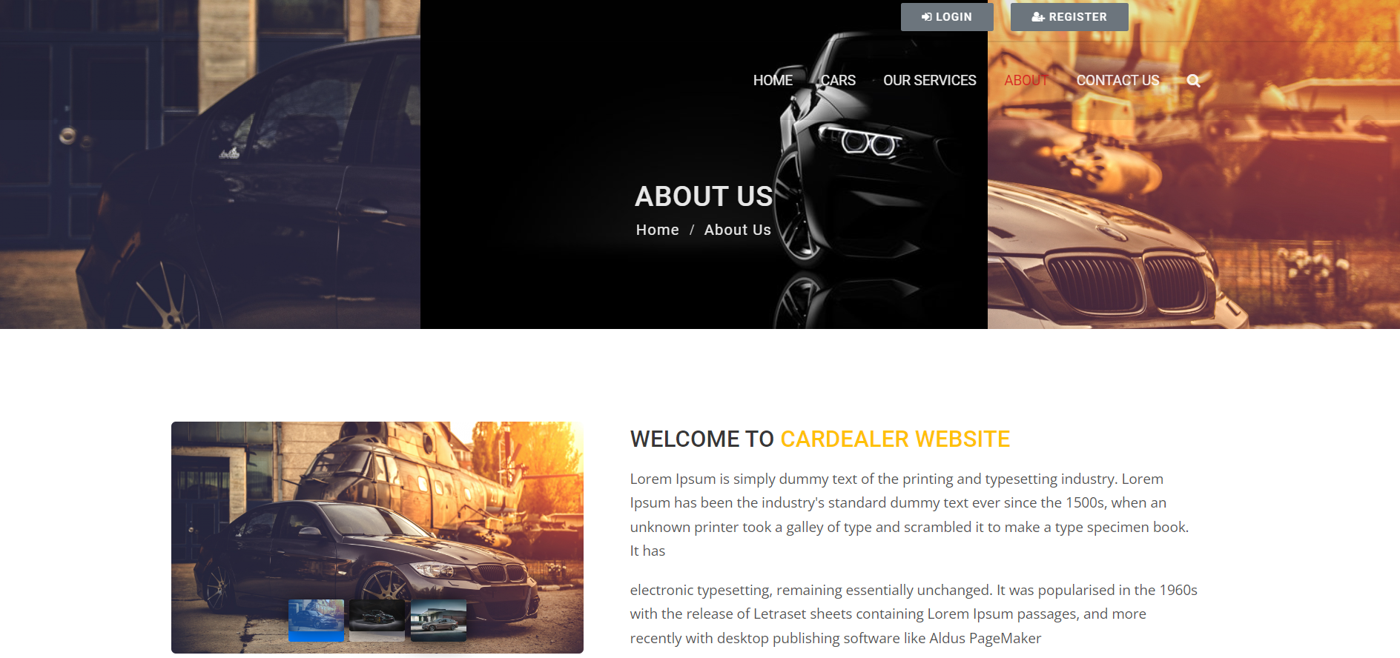
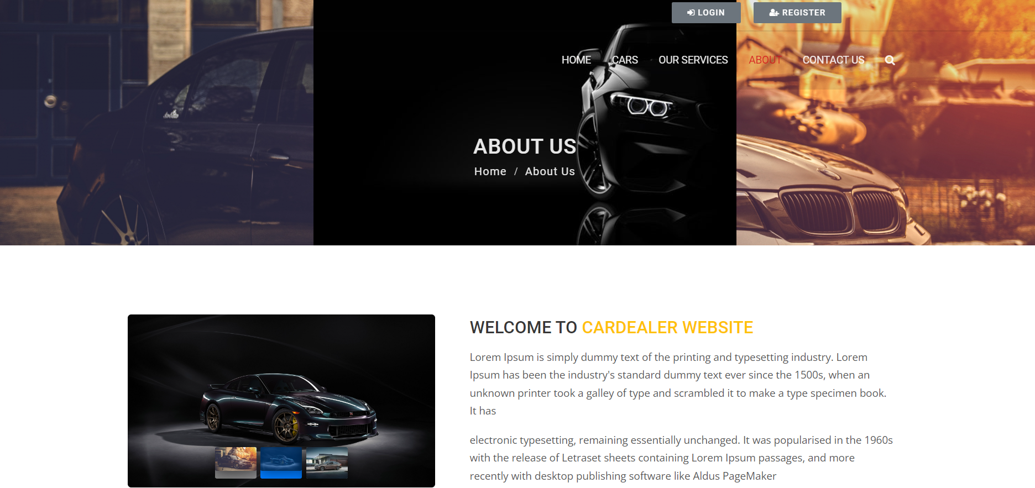
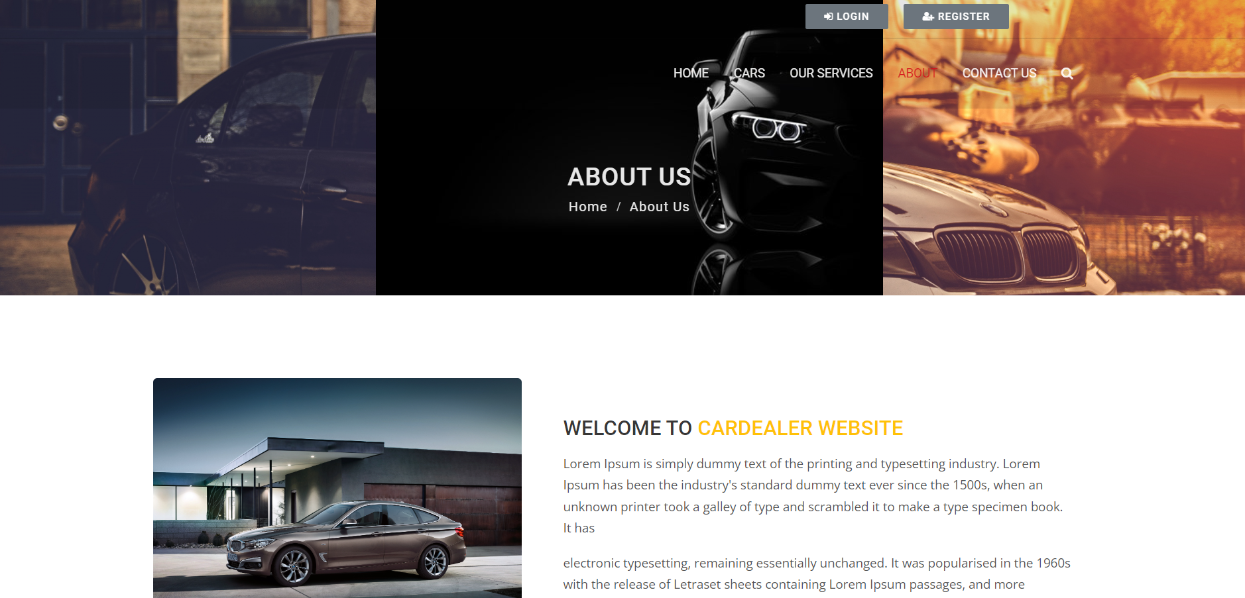
About-Us-Page

Slide 13
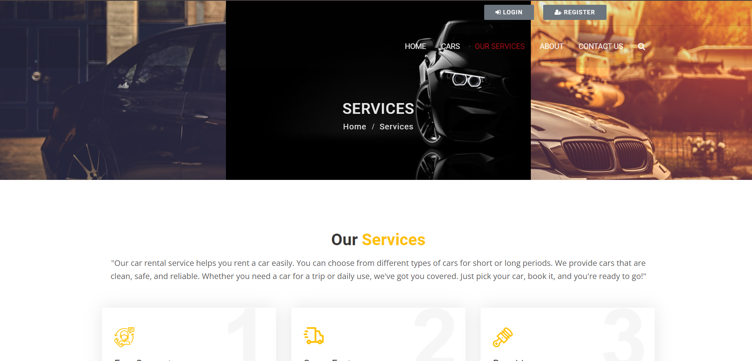
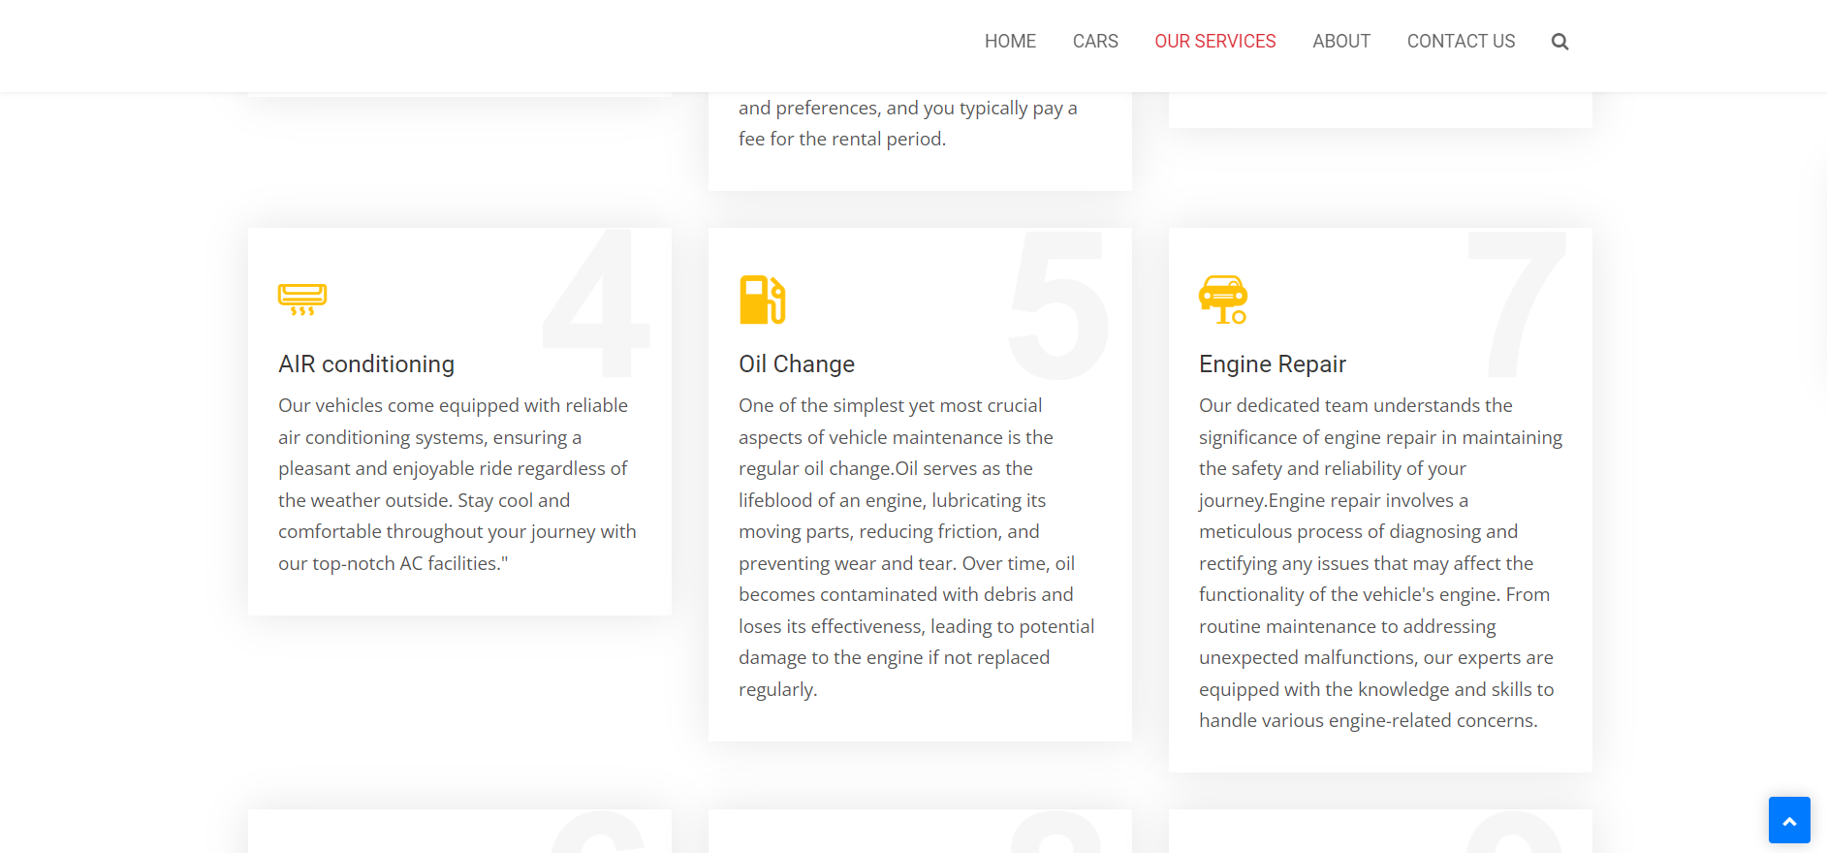
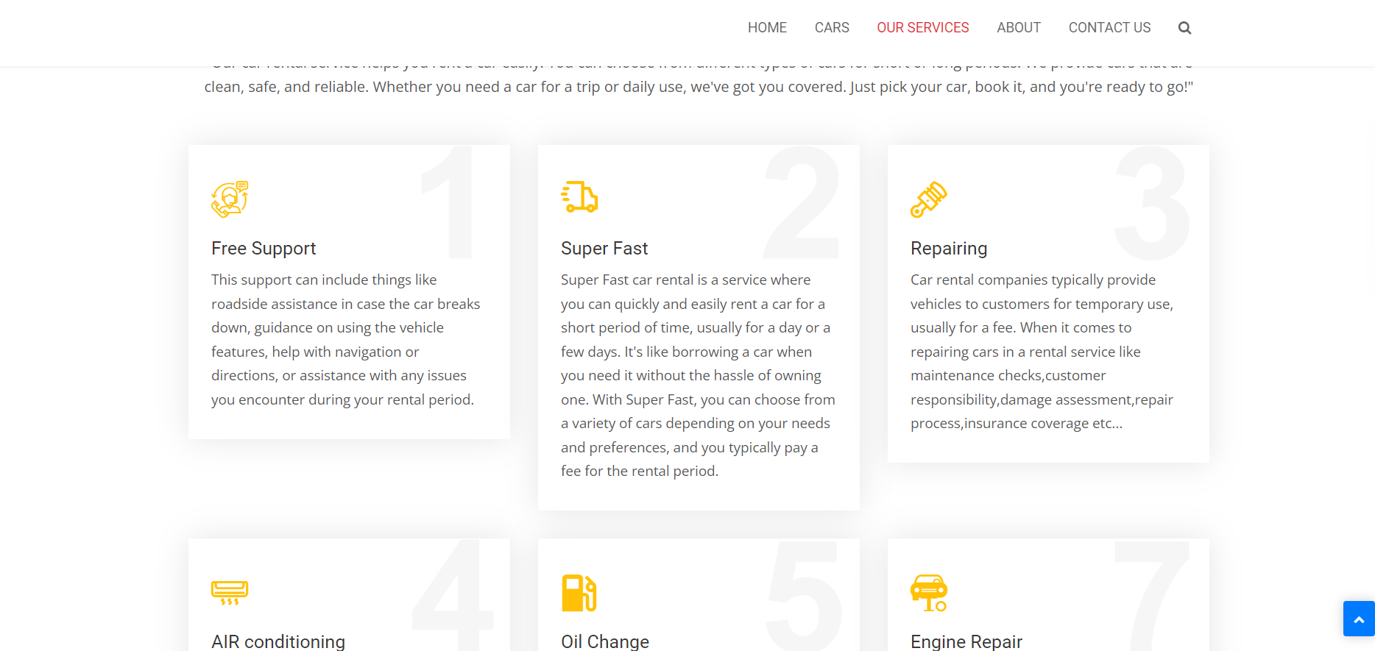
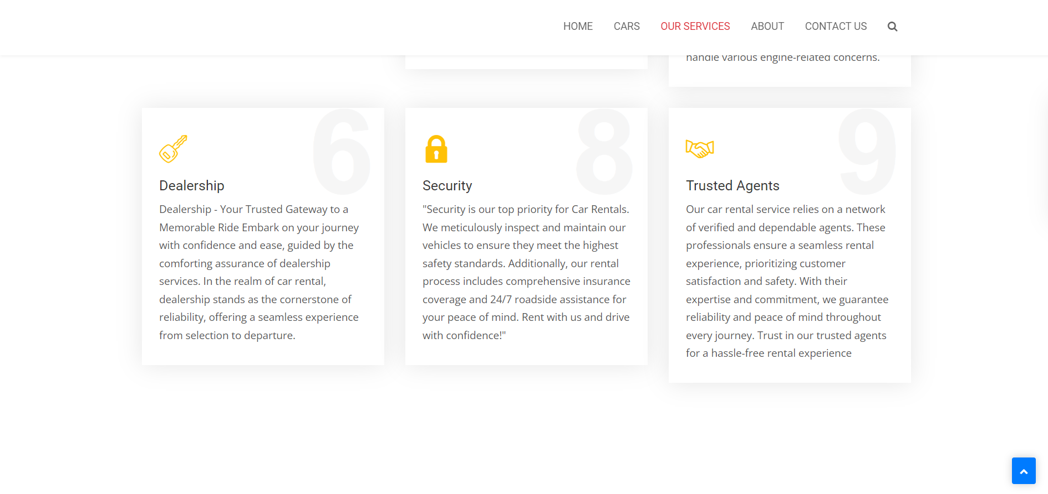
Service-Page

Slide 14
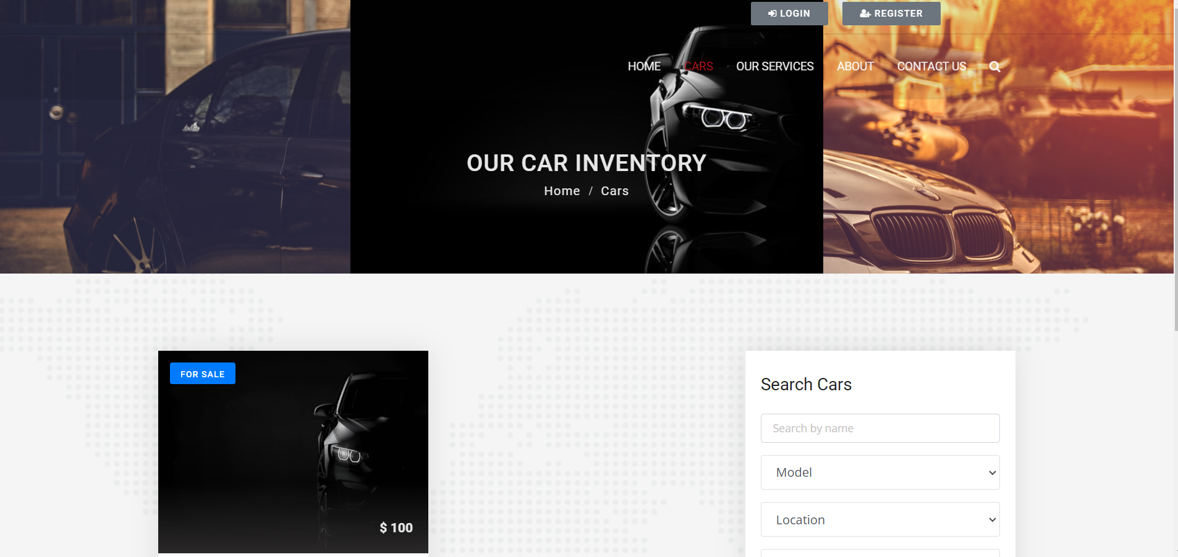
OUR CAR INVENTORY

Slide 15
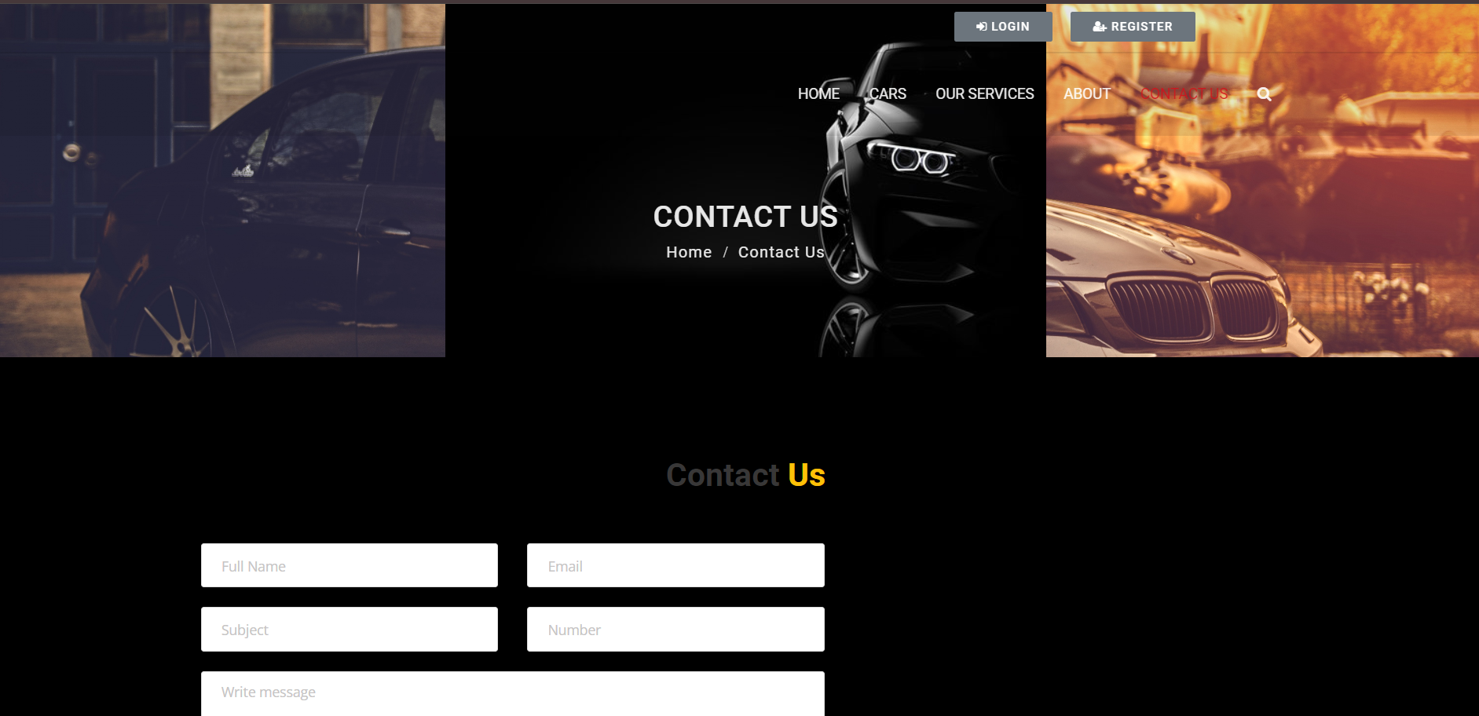
CONTACT US

Slide 16
Future Enhancements: Future Enhancements for Car Rentals Application with Django Framework: 1) User Profiles and Preferences 2) Integration of Payment Gateways 3) Real-Time Availability Updates 4) Enhanced Search and Filtering Options 5) Mobile Application Development 6) Feedback and Rating System 7) Vehicle Tracking and Management 8) Promotions and Loyalty Programs 9) Multilingual Support 10) Data Analytics and Reporting

Slide 17
Conclusion: In conclusion, the development of a Car Rentals Application using the Django Framework offers numerous benefits for both users and administrators. Through its robust features and efficient design, the application provides a seamless experience for customers to browse, book, and manage their car rental reservations. Utilizing Django's powerful backend capabilities ensures secure data handling and smooth transaction processing. Moreover, the flexibility and scalability of Django allow for easy customization and future enhancements to meet evolving business needs. Overall, the Car Rentals Application built on the Django Framework presents a modern and reliable solution for the car rental industry, enhancing convenience and satisfaction for all stakehold involved.
Source :

Slide 18
Thank You!
Notes:
Thank You !!

